Slide 1
Neural Decoding by Kalman Filter and Sequential Monte Carlo Methods
Xue Huang
Department of Statistics, FSU

Slide 2
Overview
Goal: Neural decoding
Model Identification--Kalman Filter Model
Neural Decoding----making inference
Kalman filter
Sequential Monte Carlo Method
Comparison of the two inference methods

Slide 3
Data Structure
Training data
Two variables: kin ( ) and rate ( ).
: in denote x-position, y-position, x-velocity and y-velocity in hand movement at time t.
: spiking rate of neurons in the motor cortex at time t.
Test data

Slide 4
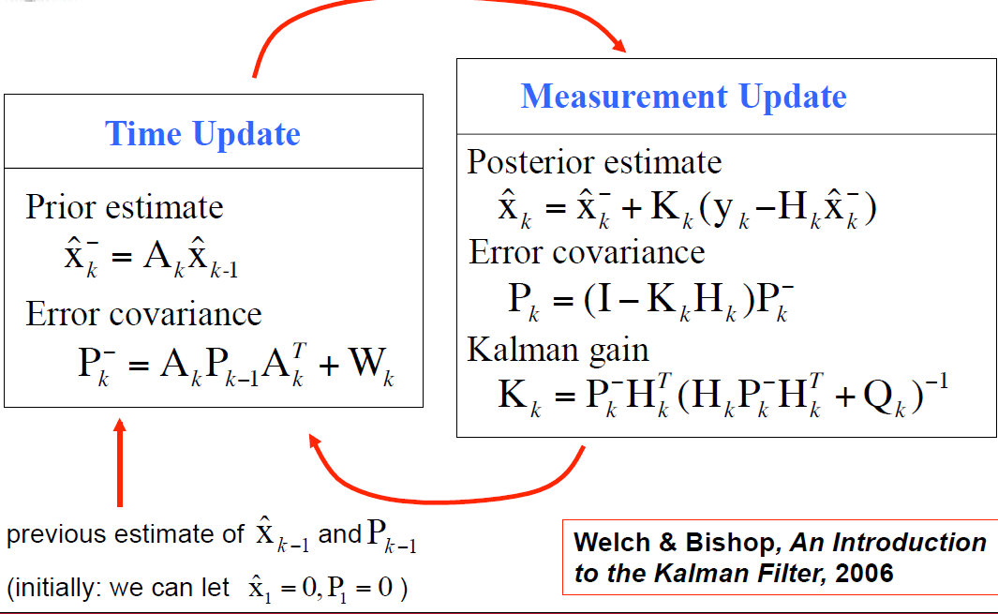
Algorithm Overview
Kalman filter

Slide 5
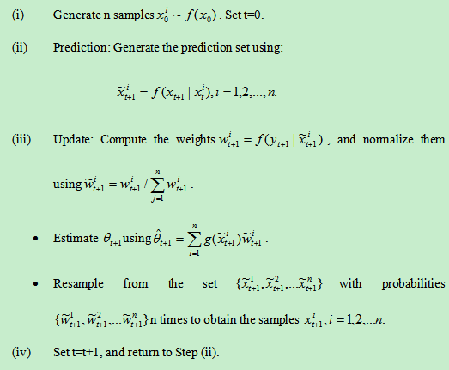
Algorithm Overview
Sequential Monte Carlo method

Slide 6
Experiment Result(Kalman Filter)

Slide 7
Experiment result-SMCM

Slide 8
Comparison between two methods
Estimation accuracy
 |  |  | x-position | y-postion
 |  | Kalman Filter | 0.4908 | 0.8384
 |  | Sequential MCM n=20 | 0.2557 | 0.7638
 |  | n=50 | 0.361 | 0.8071
 |  | n=100 | 0.4223 | 0.8214
 |  | n=500 | 0.4705 | 0.8329

Slide 9
Comparison between two methods
Computation time
 |  |  | time
 |  | Kalman Filter | 2.1023s
 |  | Sequential MCM n=20 | 6.1118s
 |  | n=50 | 14.7782
 |  | n=100 | 29.9702s
 |  | n=500 | 151.7672s

Slide 10
Summary
Both of them are good estimate for the hand movement.
Kalman filter method performs better and consistent result than Sequential Monte Carlo Methods.
As sample size increase, Sequential Monte Carlo Methods has increasing higher estimation accuracy.
Kalman filter compute faster than Sequential Monte Carlo method.

Slide 11
Thank you!

